Slide 1
HOTEL MANAGEMENT AND HOSPITALITY
Database Programming Capstone Project
PRESENTED BY Umutoni
STUDENT ID 32378/2025
COURSE DPR400210 – Database Programming
INSTITUTION University of Lay Adventist of Kigali (UNILAK)
FACULTY Faculty of Computing and Information Science
ACADEMIC YEAR 2025–2026

Slide 2
Introduction
Background
.Hotels manage guests, reservations, rooms, payments, and staff activities daily.
.Many hotels still rely on manual records and spreadsheets.
.This results in delays, billing errors, and poor room tracking.
Project Goal
To design and implement a Microsoft SQL Server database system that automates:
Guest management
Room reservations
Check-in and check-out
Billing and payments
Staff assignments
Service requests
Management reporting

Slide 3
WHY THIS MATTERS
Problem Statement
Hotels and hospitality businesses often manage operations manually.
Key Issues
Double booking of rooms.
Incorrect billing and payment records.
Difficulty tracking room availability.
Delays during check-in and check-out.
Limited reporting and business analysis.
No automated enforcement of business rules.

Slide 4
WHO IT'S FOR
Target Users
1. Guests
Make reservations.
Request hotel services.
Track their bookings and payments.
2. Receptionists and Staff
Register guests.
Manage reservations.
Process check-ins and check-outs.
Generate bills and payments.
3. Hotel Managers
Monitor hotel performance.
Analyze revenue and occupancy rates.
Generate operational reports.

Slide 5
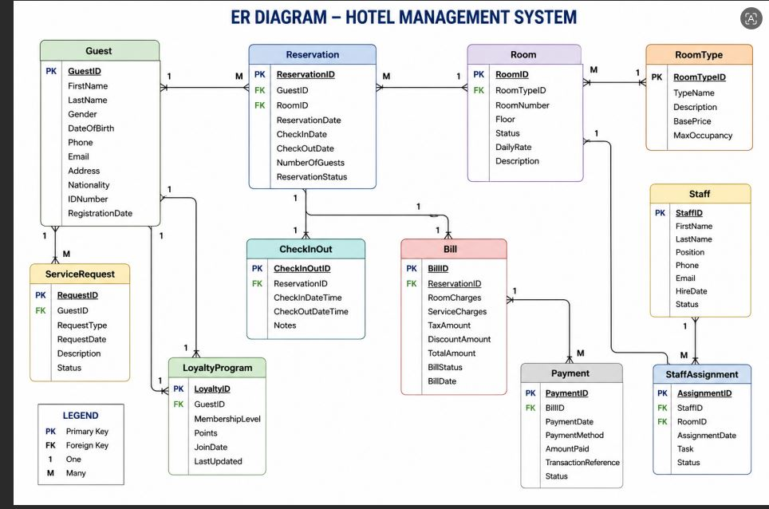
DATABASE DESIGN Entity Relationship Diagram (ERD) MAIN TABLES (3NF NORMALIZED)
Guest
RoomType
Room
Reservation
CheckInOut
Bill
Payment
Staff
StaffAssignment
ServiceRequest
LoyaltyProgram
Relationships
Guest 1 Reservation
RoomType 1 Room
Room 1 Reservation
Reservation 1:1 Bill
Bill 1 Payment
Staff 1 StaffAssignment

Slide 6
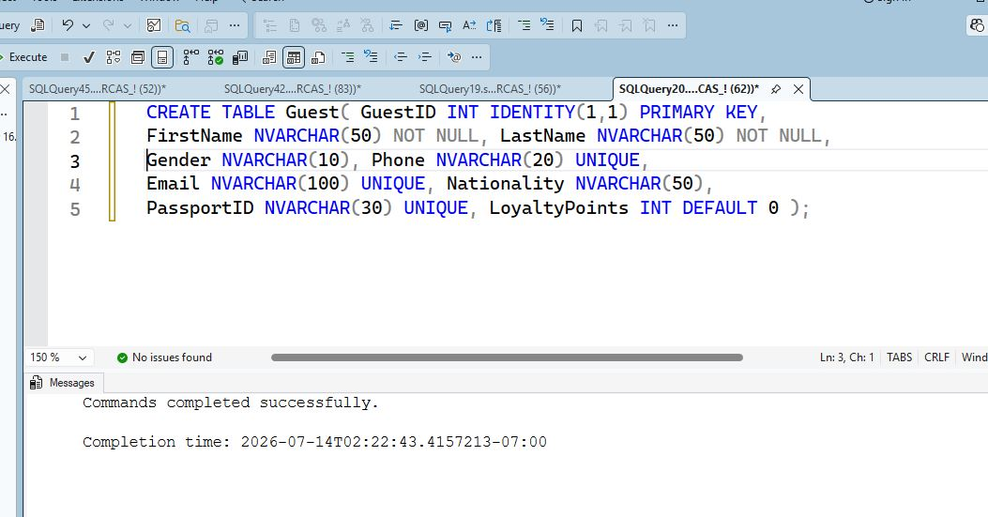
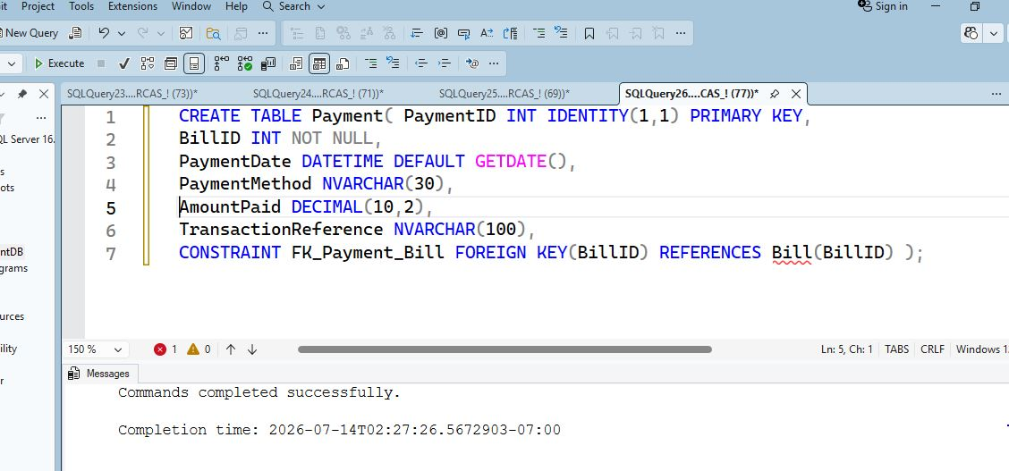
IMPLEMENTATION Database Tables and Constraints
Primary Keys for unique identification.
Foreign Keys for relationships.
CHECK constraints for validation.
UNIQUE constraints for important fields.
DEFAULT values for statuses and dates.
Example Tables
Guest
Room
Reservation
Payment
Staff

Slide 7
BUSINESS LOGIC
SQL Server Implementation
Stored Procedures
sp_CreateReservation
sp_GenerateBill
sp_ProcessPayment
sp_Hotel_Dashboard_Report
Functions
fn_TotalBill
fn_OccupancyRate
fn_DiscountCalculation
Triggers
Prevent double booking.
Update room status automatically.
Audit important changes.

Slide 8
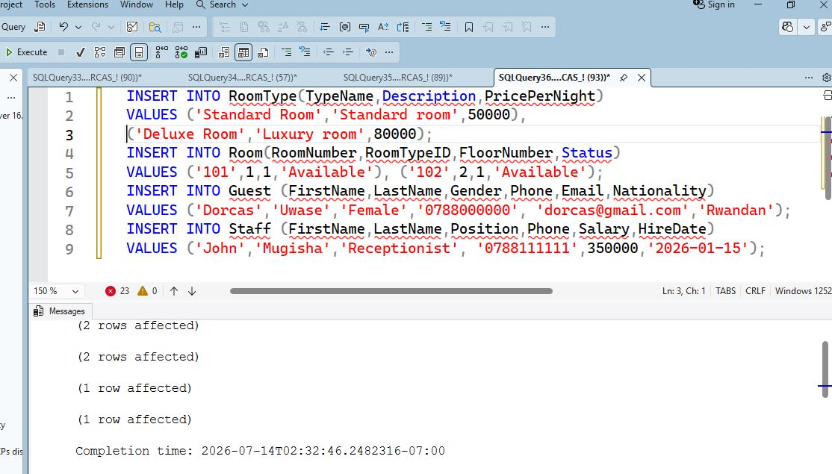
VERIFICATION
Testing and Results
Sample Data Inserted
Guests
Rooms
Reservations
Payments
Staff records
Tests Performed
✔ Reservation creation
✔ Payment processing
✔ Billing generation
✔ Trigger execution
✔ Dashboard reporting
✔ Room availability validation

Slide 9
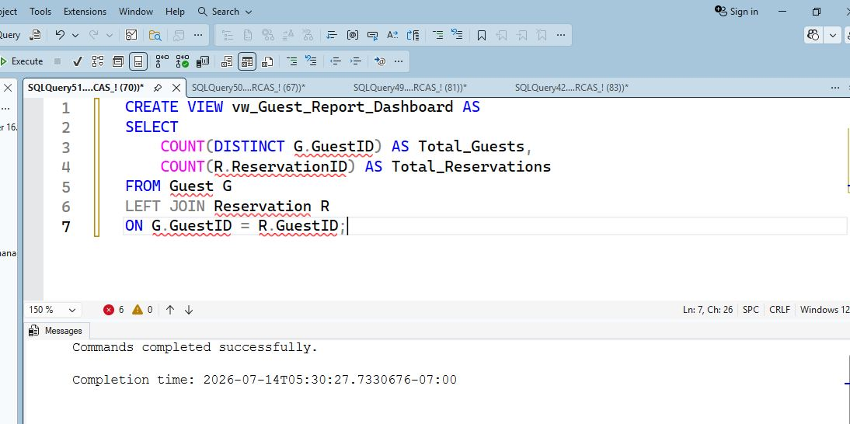
GOING FURTHER
Innovation Component – Data Reporting Dashboard
Dashboard Features
Room Occupancy Analysis
Monthly Revenue Reports
Reservation Statistics
Payment Status Tracking
Guest Activity Reports
Room Performance Analysis
Benefits
Supports management decisions.
Provides real-time hotel performance analysis.
Improves operational efficiency.

Slide 10
WRAPPING UP
Conclusion
Project Summary
Developed a complete hotel database system using Microsoft SQL Server.
Automated reservations, billing, payments, and reporting.
Enforced business rules using triggers and constraints.
Implemented procedures, functions, and views.
Created a Data Reporting Dashboard for analysis.
Future Enhancements
Online booking platform.
Mobile application integration.
AI-based customer recommendations.
Advanced analytics and forecasting.
THANK YOU!!!!!!

